Slide 1
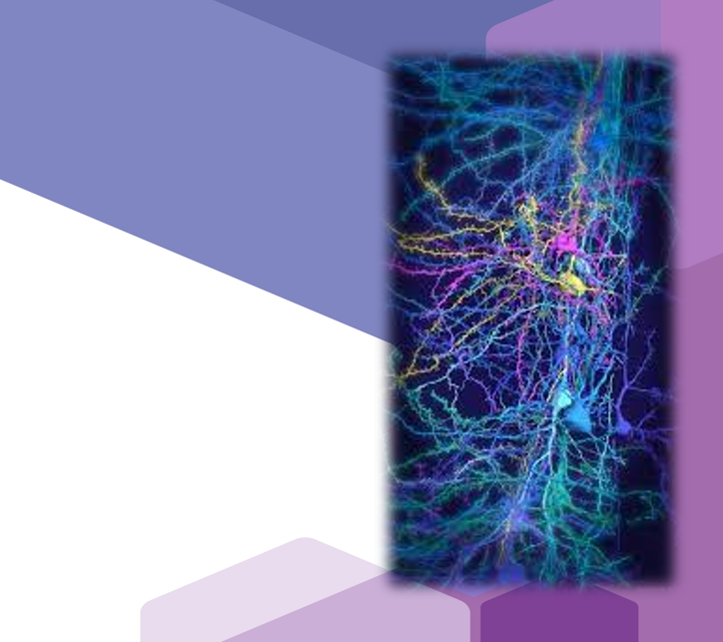

PSP in Practice - Neurology
Population Science & Policy and Neurology for Students, Residents, and Faculty
Notes:
1. Hello, everybody. This is Jeremy Kulacz, your year 3 neurology clerkship director. Thank you for taking the time to listed to this presentation on population science and policy topics in neurology.

Slide 2
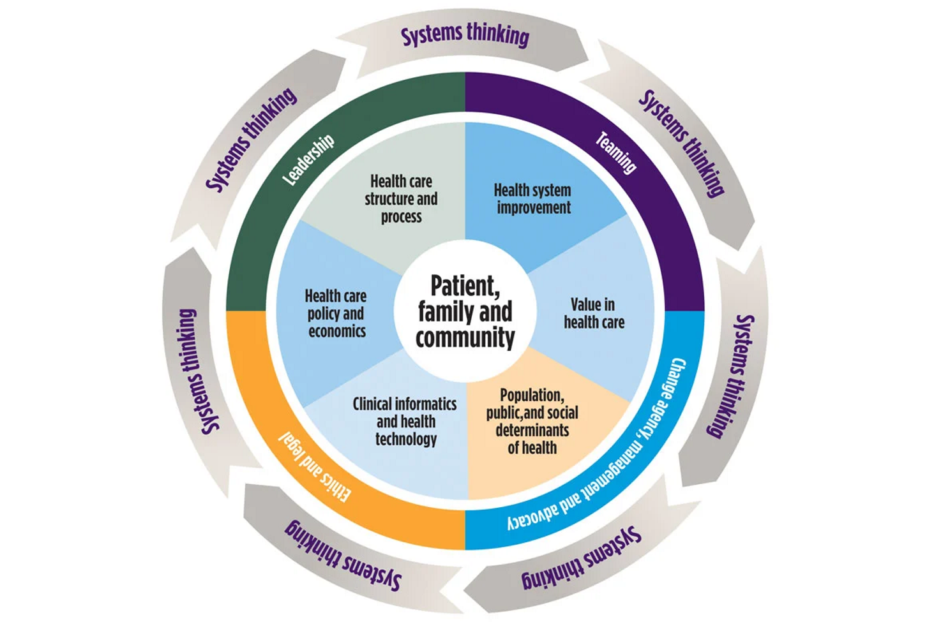

Health Systems Science
Ethics and legal
Notes:
2. As you are aware, health systems science is a framework for the understanding of how care is delivered, how health professionals deliver that care, and how the healthcare system can improve health and health care delivery. This framework encompasses several domains, one of which is medical ethics. In this talk, we will be reviewing the basics of medical ethics, and how ethical and legal issues present within the field of neurology .

Slide 3
What is medical ethics?
Modern medical ethics is grounded in four basic principles:
Patient Autonomy
Beneficence
Nonmaleficence
Justice
Notes:
3. To best appreciate how ethical and legal issues present in neurology, we must first have an understanding of the basic principles of medical ethics. Modern medical ethics is grounded in four basic principles: These are PATIENT AUTONOMY, BENEFICENCE, NONMALEFICENCE, and JUSTICE. We will review each independently.

Slide 4
Respect for patient autonomy
Health care providers must:
Respect patient’s capacity for rational self-determination
Allow patients to exercise some degree of control over their own medical care
Allow patients to make informed and uncoerced decisions to consent to or refuse medical interventions
*The concept of obtaining informed consent for significant medical interventions is derived from this principle
Notes:
4. The principle of RESPECT FOR PATIENT AUTONOMY dictates that health care providers must: Respect the patient’s capacity for rational self determination; Allow patients to exercise some degree of control over their own medical care; and allow patients to make informed and uncoerced decisions to consent to or refuse medical interventions. *Notably, the concept of obtaining INFORMED CONSENT for significant medical interventions is derived from this principle.

Slide 5
beneficence
Requires healthcare providers to promote their patients welfare, particularly their health
A moral duty to promote the course of action which the physician genuinely believes is in the best interest of the patient
Notes:
5. On to the principle of Beneficence. The principle of BENEFICENCE requires that healthcare providers always promote their patient’s welfare, particularly in regard to their health. This is a moral duty to promote the course of action which the physician genuinely believes is in the best interest of the patient.

Slide 6
Nonmaleficence (“First, do no harm”)
Requires healthcare providers to avoid and avert any harm to their patients
Requires every medical action to be weighed against all benefits, risks, and consequences
Occasionally, no treatment may be the best treatment
*Closely tied to the principle of beneficence
*The principle of respect for autonomy often comes into conflict with the principles of beneficence/nonmaleficence, when patients/surrogates refuse beneficial treatments or request potentially harmful interventions
Notes:
6. Next, we will discuss NONMALEFICENCE. The principle of NONMALEFICENCE is embodied in the tenet of “FIRST, DO NO HARM.” This principle requires that healthcare providers avoid and avert any harm to their patients; and requires that every medical action be weighed against all benefits, risks, and consequences. Occasionally, no treatment may be the best treatment. *This principle is closely tided to the principle of beneficence. The principle of respect for autonomy often comes into conflict with the principles of beneficence and nonmaleficence when patients or surrogates refuse beneficial treatments or request potentially harmful interventions.

Slide 7
justice
Requires that healthcare providers
Take into account the effect of their actions on parties other than the current patient
Attempt to ensure that the benefits and burdens of healthcare are distributed fairly
*Relevant in regard to
circumstances of limited supply
Ex, allocation of beds in the neurocritical care unit
decisions to limit access to expensive therapies with little marginal benefit
Ex, MRI for uncomplicated back pain
Notes:
7. Finally, we will review the principle of JUSTICE. This ethical principle requires that healthcare providers TAKE into account the effect of their actions on parties other than the current patient, and attempt to ensure that the benefits and burdens of healthcare are distributed fairly. This is particularly relevant in regard to circumstances of limited supply (such as allocation of beds in the neurocritical care unit), or decision to limit access to expensive workup/therapies with little marginal benefit (for instance, use MRI for evaluation of uncomplicated back pain)

Slide 8

How do Ethical and legal issues present in the care of Neurology patients?
Notes:
8. Having reviewed these fundamental underpinnings of medical ethics, we will now move to discussion of how ethical and legal issues present in the care of neurology patients.

Slide 9
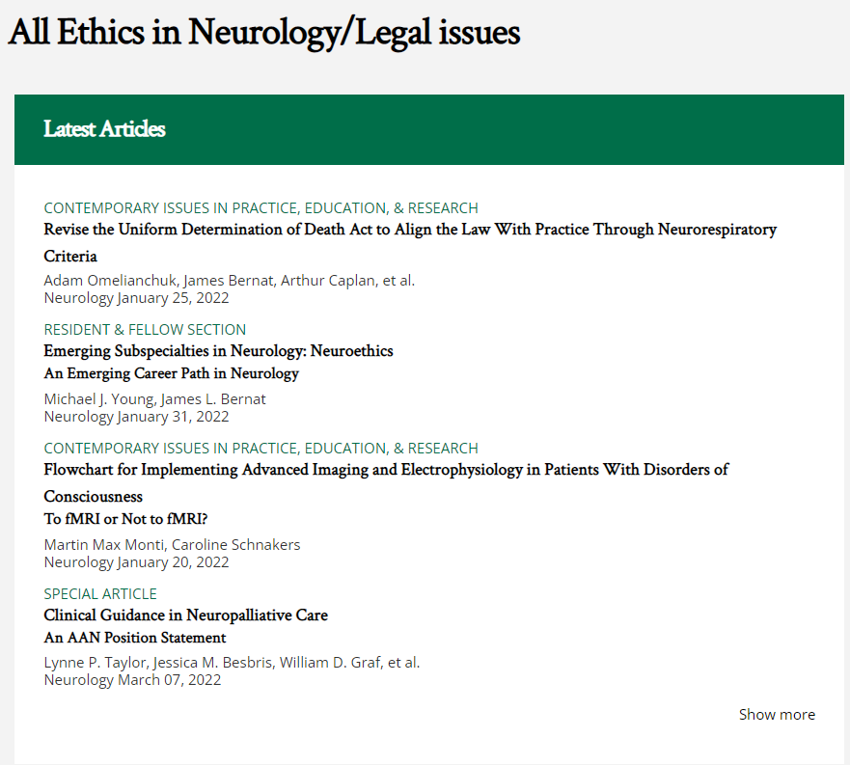

Ethics and legal issues in Neurology
Notes:
9. A quick internet search on ethical issues in neurology will turn up multiple examples and relevant publications. In this talk, we will review a select few.

Slide 10


Pre-clerkship Survey
Notes:
10. But before doing so, we ask that you take a moment to complete our pre-clerkship population science and policy survey, which can be access through the QR code on your screen. (wait approx 20 seconds before moving on).

Slide 11

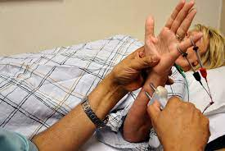
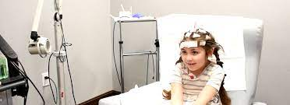
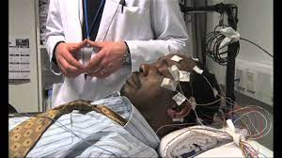
Examples of PSP in NEUROLOGY
https://nyulangone.org/locations/neurosurgery/common-neurological-tests
Notes:
11. Thank you. We will now review some select examples of population science and policy issues in neurology, specifically ethical and legal issues.

Slide 12
Death
Brain Death/Death By Neurologic Criteria
Persistent Vegetative State
Provider vs lay person perspective
Famous Cases: Terri Schiavo, Jahi McMath
Notes:
12. We will begin with the topic of dealing with death. Specifically, we will look at definitions and determination of death by neurologic criteria, including notion of persistent vegetative state; As well, we will review the famous case of Terri Schiavo. For another example, you may consider researching the similar case of Jahi McMath.

Slide 13
Death
Neurologic definition of death:
“Irreversible loss of the capacity for consciousness combined with the irreversible loss of all brainstem functions, including the capacity to breathe.”
“Brain death” signifies the complete, irreversible cessation of brain function, including the capacity for the brainstem to regulate respiratory and vegetative activities.
Notes:
13. The neurologic definition of death is “IRREVERSIBLE loss of the capacity for consciousness combined with the irreversible loss of all brainstem functions, including the capacity to breath. In other words, the term “BRAIN DEATH” signifies the complete, irreversible cessation of brain function, including the capacity for the brainstem to regulate respiratory and vegetative activities.

Slide 14
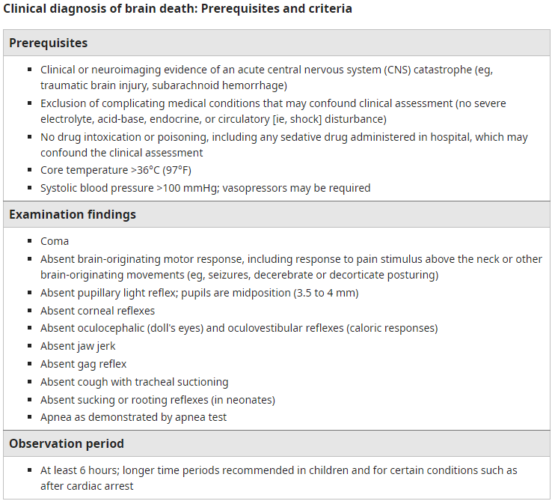
DIAGNOSIS of Brain death
*One of the most challenging, (clinically and ethically) situations encountered by neurologists.
Strict criteria/algorithms exist to guide this process
Notes:
14. The diagnosis of brain death is one of the most challenging (both clinically and ethically) situations encountered by neurologist. To avoid misdiagnosis, strict criteria and algorithms exist to guide this process. You ma review these critieria to the right (hold 20 seconds).

Slide 15
Brain death- grey areas
Coma
Persistent Vegetative State
Criteria:
No meaningful interaction with the environment
May have reflexive responses such as withdrawal to noxious stimuli
Preservation of brainstem function
Not awake (persistently)
Criteria:
No meaningful interaction with environment
Preservation of brainstem function
*Preserved sleep wake cycle (intermittent wakefulness)
*While these criteria exist, evaluation of comatose/PVS patients may not always be as clear cut, and different opinions may be formed by different examiners, leaving prognosis unclear.
*This has led to several controversial cases which received national attention.
Notes:
15. Despite strict criteria for diagnosis of brain death, there are gray areas wherein certain criteria are met, but others are not, in which patients cannot be definitively pronounced as brain dead. These include the states of COMA and PERSISTENT VEGETATIVE STATE. The diagnosis of COMA indicates that the patient has no meaningful interaction with the environment. Patients may exhibit reflexive responses such as withdrawal to noxious stimuli, and this should not be mistaken as true interaction with the environment. Further, there will be preservation of brainstem function. These patients will not be awake. This lack of wakefulness is persistent. That is, there is no sleep wake cycle.
The diagnosis of PERSISTENT VEGETATIVE STATE differs. In this state, the patient will also have no meaningful interaction with the environment, and will also have preservation of brainstem function. However, in persistent vegetative state, there is preservation of the sleep wake cycle such that patients will have intermittent periods of wakefulness.
While these criteria exist to aid diagnosis, evaluation of comatose or persistent vegetative state patients may not always be as clear cut, and different opinions may be formed by different examiners, leaving prognosis unclear. *This has led to several controversial cases which received national attention.

Slide 16
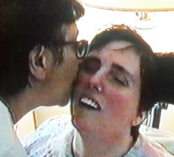
Terri Schiavo case- 1990
26 year old female who suffered anoxic brain injury after cardiac arrest.
Though she did not require long term ventilator support, she did require life-sustaining measures in the form of a PEG tube (“feeding tube”).
Diagnosed with persistent vegetative state based on lack of neurologic recovery
*Had multiple exams by different neurologists, some of whom agreed with, and some who disagreed with, the diagnosis of PVS
Notes:
16. Arguably the most famous of such cases is that of Terri Schiavo, which began in 1990. Ms Schiavo was a 26 year old female who suffered anoxic brain injury after cardiac arrest. Though she did not require long term ventilator support, she did require life-sustaining measures in the form of a PEG tube (aka feeding tube). She was diagnosed with persistent vegetative state based on lack of neurologic recovery. *Of note, she had multiple exams by different neurologist, some of whom agreed with, and some who disagreed with, the diagnosis of persistent vegetative state.

Slide 17
Terri Schiavo case- 1990
Ms Schiavo did not have an advanced directive (no will or power of attorney)
Husband was given legal guardianship (to which her parents objected)
Over the next decade, Ms Schiavo did not improve, and it was concluded her condition was permanent.
Husband did not think that living in persistent vegetative state was compatible with her wishes, and opted to have the PEG tube removed.
Her parents disagreed, and the issue went to court.
Court ultimately ruled in favor of the husband, and the PEG was removed in 2003
Notes:
17. Ms Schiavo did not have an advanced directive. That is, no living will or power of attorney. Ultimately, her husband was given legal guardianship. Her parents objected to this guardianship decision. Over the following decade, Ms Schiavo’s neurologic status did not improve, and it was concluded that her condition was permanent. Her husband did not think that living in a persistent vegetative state was compatible with her wishes, and opted to have her PEG tube removed. Her parents disagreed with this decision, and the issue went to court. The court ultimately ruled in favor of the husband, and the PEG tube was removed in 2003.

Slide 18
Terri Schiavo case- 1990
Parents subsequently appealed to the state legislature, and a law was passed by the governor which gave him the authority to order the feeding tube to be replaced
After multiple appeals and over 1 year later, the state supreme court ruled the law unconstitutional, and ordered the feeing tube removed.
Terri Schiavo passed away in March of 2005 (15 years after her anoxic brain injury)
Notes:
18. But this would not the end of the matter. Ms Schiavo’s parents subsequently appealed to the state legislature , and a law was passed by the governor which gave him the authority to order the feeding tube to be replaced. After multiple appeals and over 1 year later, the state supreme court ruled the law unconstitutional, and ordered the feeding tube removed. Terri Shiavo then passed away in March of 2005, 15 years after her initial anoxic brain injury.

Slide 19
Ethical/LEGAL issues in Schiavo case
Was the diagnosis of persistent vegetative state correct?
Dispute amongst examiners over whether she was truly in PVS, or whether there was some degree of consciousness, clouded prognosis and decision-making.
Patient’s wishes in regards to quality of life not known
No will/POA assigned
Husband given guardianship, but parents disagreed
Should the parents (and subsequently the governor) have been able to intervene as they did?
Ethical principles relevant in this case:
Beneficence
Nonmaleficence
Notes:
19. This was difficult case from an ethical and legal standpoint due to a couple of factors. For one, there was lack of clarity on the diagnosis of persistent vegetative state. Was this diagnosis correct? It was unclear due to dispute amongst examiners over whether she was truly in persistent vegetative state, or whether there was some degree of consciousness, and this clouded the overall prognosis and impaired decision-making. Secondly, the patient’s wishes in regards to quality of life were not known prior to her injury. There was no living will or assigned POA. Gaurdianship was given to her husband, though her parents disagreed. Should the parents (and subsequently the governor) have been able to intervene as they did? In evaluating ethical issues that we encounter in our neurology patients, we should attempt to which of the four principles of medical ethics are involved. In this particular case, we can clearly see the principles of BENEFICENCE and NONMALEFICENCE invoked.

Slide 20
Capacity and consent
Common law dictates that individuals possess autonomy and self determination
Includes the right to accept or refuse medical treatment
Many neurologic conditions may affect a patient’s ability to make rational decisions about their health care (Ie, to agree to or refuse interventions)
Ex, acute encephalopathy/delirium, dementia, stroke, etc
An ethical conundrum arises when such issues interfere with a patient’s ability to make informed healthcare decisions
Notes:
20. Moving on to our next example.. we will review the concept of CAPACITY AND CONSENT. Common law dictates that individuals possess autonomy and self-determination, which includes the right to accept or refuse medical treatment. Many neurologic conditions may affect a patient’s ability to make rational decisions about their health care (that is, to agree to or refuse intervention). Examples include cases of acute encephalopathy or delirium, dementia, and stroke, among others. An ethical conundrum arises when such issues interfere with a patient’s ability to make informed healthcare decisions.

Slide 21
Capacity and consent
Definitions
Informed consent
A process by which communication between a physician and patient results in the patient’s authorization to undergo (or decline) a specific medical intervention
Elements of informed consent:
Disclosure of information
Voluntary choice (no coercion by clinician)
Patient capacity to decide
Informed consent is required in all cases with exceptions such as emergency, waiver (patient waives right to consent), and lack of capacity
Capacity
The ability to accept or refuse interventions/treatments/recommendations
Patient must be able to understand the nature of the recommendation, and judge risks/benefits for themselves
This is determined by a clinician
Competency
Legal term, determined in court based on a judge’s review of physician opinion
Notes:
21. So how are capacity and consent defined? When we talk about consent in regard to medical interventions, we are talking about the notion of INFORMED CONSENT. Informed consent is a process by which communication between a physician and a patient results in the patient’s authorization to undergo (or decline) a specific medical intervention. Elements of informed consent include DISCLOSURE OF INFORMATION, VOLUNTARY CHOICE (that is, there is no coercion by the clinician), and the requirement that the patient has CAPACITY to decide. Informed consent is REQUIRED in all cases with exceptions such as emergency, waiver (wherein the patient has waived their right to consent), and LACK OF CAPACITY.
So what is CAPACITY? CAPACITY is the ability to accept or refuse interventions, treatments, and other recommendations. To demonstrate capacity, the patient must be able to understand the nature of the recommendation, and judge the risks/benefits for themselves. Whether a patient has this capacity is determined by a clinician.
Often in ethical/legal cases in medicine, the concept of COMPETENCY will come up. Please note that COMPETENCY is not the same as CAPCITY. COMPETENCY is a legal term, and is determined in court based on a judge’s review of physician opinions. A single clinical DOES NOT make a determination of competency.

Slide 22
Determining capacity
Any physician can determine capacity (does not need to by psych)
Capacity exists on a spectrum and is dependent on the decision being addressed
Patient may have capacity in regard to low risk issues, such as refusing blood draws..
but lack capacity in regard to high risk-to-benefit issues, such as declining urgent interventions (ex, thrombolytic therapy and/or mechanical thrombectomy in stroke patients)
Capacity may change over time, depending on situation
Ie, acutely delirious patients may temporarily lack capacity, but will regain capacity when the condition clears
Notes:
22. How Do We Determine Capacity then? Any physician is capable of determining whether their patient has capacity, not just psychiatry as some may think. It is important to remember that capacity exists on a spectrum and is dependent on the seriousness of the decision being addressed. Patients may have capacity in regard to low risk issues (such as refusing blood draws), but lack capacity in regard to high risk-to-benefit issues, such as declining urgent interventions (for instance, thrombolytic therapy and/or mechanical thrombectomy in stroke patients). It is also crucial to note that capacity may change over time, depending on the situation. For instance, acutely delirious patients may temporarily lack capacity, but will regain capacity when the condition clears.

Slide 23
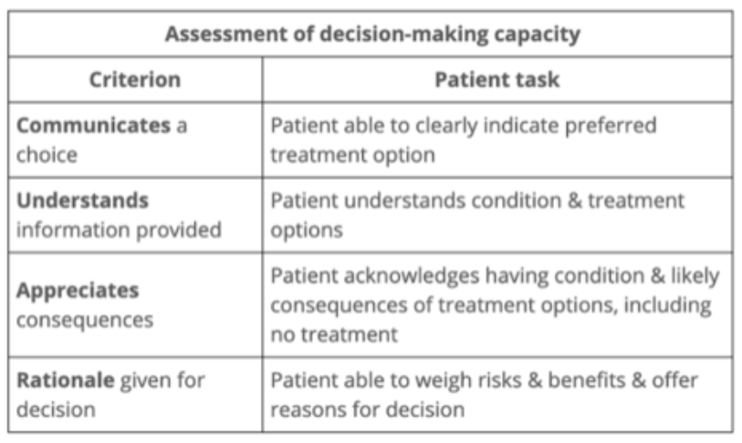
Determining capacity
Four component model of decisional capacity
Grisso and Applebaum 1998)
Notes:
23. When making capacity determinations, we follow a four component model of decisional capacity. This requires that 1) that patient can communicate their choice, clearly indicating their preferred treatment option; 2) The patient understands the condition and available treatment options; 3) The patient appreciates the consequences. That is, they acknowledge their condition and the likely consequences of treatment options, including no treatment; And 4) They have a rational for their decision. That is, the patient is able to weigh the risks and benefits, and offer reasons for their decision.

Slide 24
Capacity and consent
Lack of capacity
When a patient is determined to lack capacity, a surrogate decision maker must be utilized
Who can do this?
POA/healthcare proxy, if already established by patient if an advanced directive is in place
If not established proxy/advanced directive, then families (usually next of kin) are asked to make medical decisions on behalf of the patient
Legal implications
In cases where lack of capacity is permanent, such a progressive dementia or certain strokes, family members (or other POA) may need to pursue permanent guardianship
Long, arduous court process which removes patient’s rights to make their own medical decisions permanently, transferring that right to another party
Court decision will consider opinions/documentation from likely multiple providers
In neurology, this will include such items as progress notes, physical exam, mental status exams (MMSE, MOCA), and neuropsychiatric evaluations
Notes:
24. So what happens when a patient LACKS CAPACTY? When a patient is determined to lack decisional capacity, a surrogate decision maker must be utilized. Who can serve as this surrogate? This can be a power of attorney/healthcare proxy if this has already been established in an advanced directive. If there is no established proxy, then families (usually next of kin) are asked to make medical decision on behalf of the patient.
I had mentioned the concept of COMPETENCY previously, and this becomes relevant in cases where lack of capacity is permanent, such as progressive dementia or certain strokes. In such cases, family members may need to pursue permanent GUARDIANSHIP. Obtaining guardianship is a long, often arduous court process which removes the patient’s rights to make their own medical decisions, permanently transferring that right to another party. That is, they are declared incompetent. The court decision will consider opinions and documentation likely from multiple providers. In neurology, this will include items such as progress notes, physical exams, mental status exams (such as MMSE, MOCA), and neuropsychiatric evaluations.

Slide 25
Capacity and consent
Which ethical principles are invoked in considerations of capacity and consent?
*Respect for patient autonomy, primarily
Beneficence, maleficence, and justice too, depending on individual case
Notes:
25. Thinking back to our 4 principles of medical ethics.. which principles are invoked in considerations of capacity and consent. Primarily, the principle of RESPECT FOR PATIENT AUTONOMY is the foundational issue. This said, issues of BENEFICENCE, MALEFICENCE, and JUSTICE too may come up depending on the individual case.

Slide 26
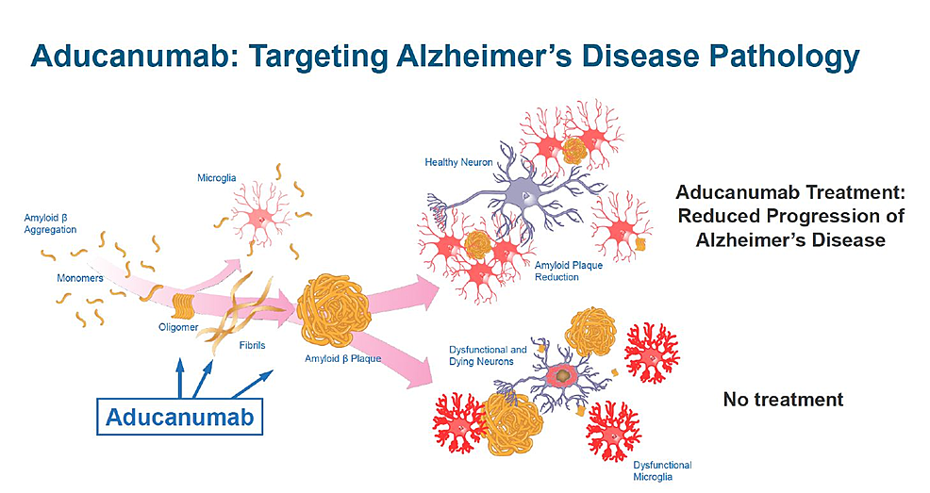
Drugs & Ethics
Alzheimers drug: Aducanamab
Aims to slow progression of AD
Mechanism of action: binds to amyloid protein, leading to clearance of plaques
1st new Alzheimer drug since 2003
i.e., great excitement over this drug. Many interested (and often desperate) patients/families looking for a cure for Alzheimer Disease
Notes:
26. Our last example in this talk will focus on the ethical use of drugs in neurology. As a prime example, we will look at the use of a recently approved drug for the treatment of Alzheimer dementia called ADUCANAMAB. This goal of this drug is to SLOW THE PROGRESSION OF ALZHEIMER DISEASE. It’s mechanism of action is binding to amyloid protein, thus leading to clearance of amyloid plaque. This drug is notable, as it is the first new drug approved for the treatment of AD since 2003. As such, there has been great excitement over the treatment; and there are many interested (and often desperate) patients and families hoping that this may be a cure to this debilitating and progressive condition.

Slide 27

Aducanamab Controversy
Trials included a limited, specific group of patients. Eligible only if:
Age <85
Confirmed mild cognitive impairment
Confirmed amyloid in brain (by lumbar puncture or imaging)
No history of intracerebral hemorrhage, TIA/stroke
No blood-thinning medications
*Drug only for AD, not for all patients with memory loss/other dementias
*Trials showed reduction in amyloid, but did not prove that aducanamab improves cognition. NO CLINICAL BENEFIT
Expedited approval by FDA
Accelerated pathway used for drugs to treat disease with no known cure, even when clinical benefit is under investigation
High cost to patients: $56K per year
Ethical principles relevant:
Beneficence
No clinical benefit to drug
Nonmaleficence
Potential for serious side effects
Justice
High cost, limited availability
https://www.dukehealth.org/blog/what-you-need-know-about-aducanumab
Notes:
27. Some of you may have heard that there is a great deal of controversy over this new drug, ADUCANAMAB. There are several reasons why. For one, the trials of this drug included only a limited, specific group of patients. Patients were only eligible if they met the following cirteria: age less than 85, confirmed mild cognitive impairment, confirmed amyloid in the brain (by lumbar puncture or imaging), no history of intracerebral hemorrhage, TIA, or stroke; no blood-thinning medications; and other types of dementia (ie non-Alzheimer) were not included. As such, the results of the trial may not be generalizable to a large number of dementia patients.
Secondly, while the trials of this drug did show a reduction in amyloid plaques, there was no actual improvement in cognition in patient’s receiving the drug. That is, there WAS NO CLINICAL BENEFIT. Remember, the proposed goal of the drug is to slow cognitive decline in AD patients. This goal was not achieved per these trials.
There is also criticism of the fact that this drug underwent expedited approval by the FDA, utilizing an accelerated pathway used for drugs to treat disease with no known cure, even when clinical benefits are under investigation.
Finally, the drug is very expensive, with a high cost to patients at 56 thousand dollars per year; a steep price when there is seemingly no clinical benefit of the drug.
… *Ethical principles relevant in this case are as follows: Beneficence, in that this is no clinical benefit to the drug. Nonmaleficence, in that there is potential for serious side effects; And Justice, owing to the high cost and thus limited availability of the drug.

Slide 28
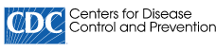
Drugs & Ethics
Gabapentin overdoses increasing – CDC MMWR, May 2022
7th most prescribed medication in the US
Anticonvulsant, postherpetic neuralgia
Multiple off label uses (neuropathic pain, headaches)
Generally considered safe
However..
*Increases effect of opiates
Also can be associated with abuse and overdose on its own
Risk of respiratory depression and death
Notes from the Field: Trends in Gabapentin Detection and Involvement in Drug Overdose Deaths — 23 States and the District of Columbia, 2019–2020 | MMWR (cdc.gov)
Notes:
28. One last example of the ethical use of drugs in neurology is the issue of gabapentin overdoses. Cases of gabapentin overdose are on the risk in recent years. Gabapentin is a common drug, and is the 7th most prescribed medication in the use. It is used as an anticonvulsant and for post-herpetic neuralgia, as well as multiple off label uses such as for other neuropathic pain and headaches. The drug is generally considered safe. However, gabapentin is known to increase the effect of opiates if taken concurrently, and can be associated with abuse and overdose on its own. Overdose carries the risk of respiratory depression and death.

Slide 29
Drugs & Ethics: Gabapentin overdoses
Gabapentin overdoses increasing – CDC MMWR, May 2022
Data:
Gabapentin exposures associated with abuse/misuse (or unknown exposures) increased by 104% from 2013-2017
Of 62,642 recorded overdose deaths from 2019-2020, 5,687 (9.7%) had gabapentin documented on toxicology
Of these 5,687 deaths, 2,975 (52.3%) were attributed to gabapentin
By the second quarter of 2020, gabapentin overdoses had doubled compared to Q1 2019.
Nearly 90% of OD deaths in which gabapentin was detected also involved an opioid, particularly illicitly manufactured opioids.
Notes from the Field: Trends in Gabapentin Detection and Involvement in Drug Overdose Deaths — 23 States and the District of Columbia, 2019–2020 | MMWR (cdc.gov)
Notes:
29. A recent publication from the CDC describes recent trends in gabapentin use and overdose. Per this review, it has been noted that gabapentin exposures associated with abuse/misuse (as well as unknown exposures) increased by 104% from 2012-2017. Of 62,642 recorded overdose deaths from 2019-2020, 5,687 (or 9.7%) had gabapentin documented on toxicology. Of these 5,687 deaths, 2,975 (or 52.3%) were attributed to gabapentin. This study also notes that by the second quarter of 2020, gabapentin overdoses had doubled compared to quarter 1 of 2019. It was also found that nearly 90% of overdose deaths in which gabapentin was detected also involved the use of an opioid, particularly illicitly manufactured opioids.

Slide 30
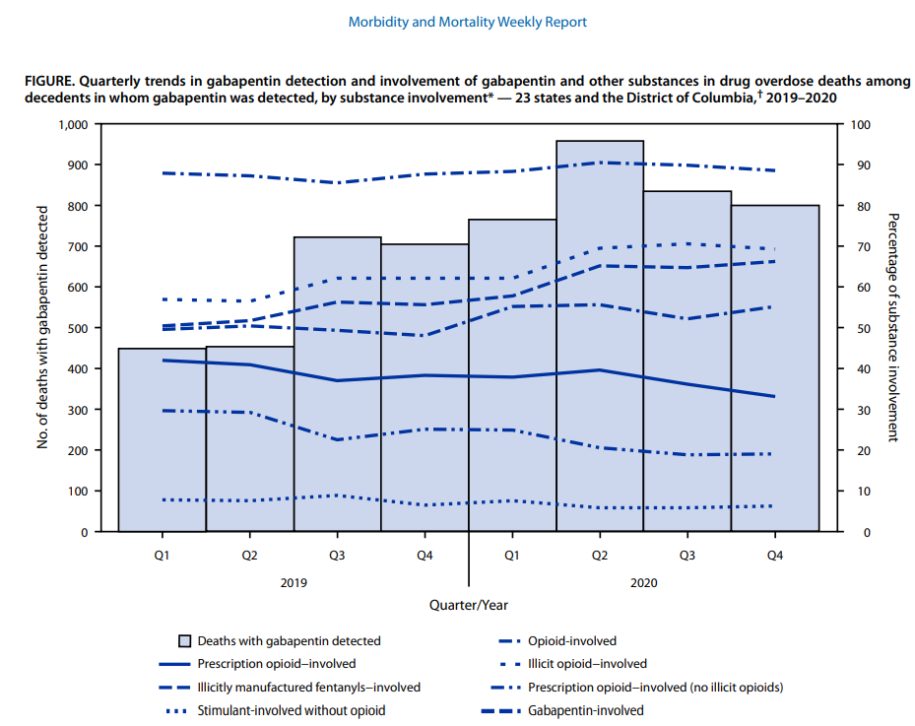
Drugs & Ethics: Gabapentin overdoses
Notes from the Field: Trends in Gabapentin Detection and Involvement in Drug Overdose Deaths — 23 States and the District of Columbia, 2019–2020 | MMWR (cdc.gov)
Notes:
30. We see these data represented pictorially in this graph, which demonstrates not only the high rates of overdose deaths in which gabapentin was combined with an opioid, but also the increasing trend of gabapentin-only overdose deaths.

Slide 31
Drugs & Ethics: Gabapentin overdoses
Takeaways:
Gabapentin, widely regarded as safe and thus prescribed with little reservation, is becoming increasingly associated with overdose deaths
Most OD deaths occur in patients also taking opioids (prescribed or illicit)
Rise in gabapentin ODs co-occurs with ongoing, increasing, opioid epidemic in US
Ethical principles relevant:
Beneficence
Nonmaleficence
Notes:
31. Takeaways on gabapentin overdoses are these. Gabapentin, which is widely regarded as safe and thus prescribed with little reservation, is becoming increasingly associated with overdose deaths. Most overdose deaths occur in patients also taking opioids (prescription or illicit). And the rise in gabapentin associated ODs appears to coincide with the ongoing, increasing, opioid epidemic in the United States.
Ethical principles relevant to this topic are beneficence and nonmaleficence.

Slide 32
Activity
Look for examples of PSP in Practice on your Neurology clerkship
Discuss with your resident or attending
Notes:
32. Here’s where you come into the picture. As you work through you neurology clerkship, please keep your eyes open for exampled of PSP topics in neurology, especially ethical and legal issues. Be sure to discuss these with your resident and/or attending physician as examples come up.

Slide 33
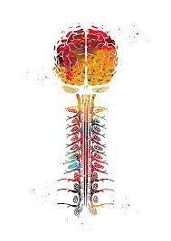
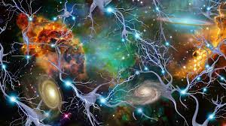
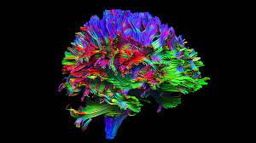
THANK YOU
PLEASE REACH OUT WITH ANY QUESTIONS AT JKULACZ45@SIUMED.EDU
Notes:
33. Thank you all for your time and attention. Please feel free to reach out to me by email with any questions.

Slide 34
REFERENCES
Mattson C, Chowdhury F, Gilson T. Trends in Gabapentin Detection and Involvement in Drug Overdose Deaths- 23 States and the District of Columbia, 2019-2020. Morbidity and Mortality Weekly Report. 2022; 71(19):664-666
Traner C, Tolchin D, Tolchin B. Medical Ethics Education for Neurology Residents: Where Do We Go From Heere? Semin Neurology. 2018; 38:497-504
https://www.dukehealth.org/blog/what-you-need-know-about-aducanumab
Notes:
34. Here are the references utilized in this talk. I would like to also add special thanks to Meredith Volle of the PSP department for her assistance in the creation of this presentation.

